Slide 1
組譯器之實作（Assembler）

Slide 2
規定一
CPU Instruction Set
SIC 及SIC/XE , 808X , Z-80 ,….任選一種
處理的指令
1. Executable Instructions
2. Pseudo Instruction
*START/END
*EQU/ORG
*Define constant/ storage( BYTE,WORD)
*LTORG
*USE BASE register

Slide 3
規定二
Literal(常數值)
包括string , character , decimal , hexadecimal
算數運算
+,-,*,/，不必處理括號
Error Diagnostic，並report Unsolved reference
不用處理項目
Macro , Multiple Segments(僅一個Control section，不用分開data segment , code segment)

Slide 4
繳交期限
Lexical Analysis （Token Report）
10月底，不用親自驗收
System Design Document
11月中旬
程式驗收(上機)
期中考後一週

Slide 5
System Design Document
選用那一個CPU？使用何種程式語言撰寫？使用何種電腦執行？
可處理那幾個pseudo Instructions , 該pseudo Instruction 做什麼工作？
Data structure 之設計(重點)
Instruction Format , Instruction type,…
Output Format

Slide 6
Example 1 - Hello World!;
Program: ; Program: Hello World !
MOV AH, 9
MOV DX, OFFSET(MESSAGE)
INT 21H ;call DOS
INT 20H ;return to DOS
MESSAGE DB 'Hello, World!$'

Slide 7
Sample Output
LOC OBJ LINE SOURCE
0100 1 ; Program: Hello World !
0100 2
0100 B409 3 MOV AH, 9
0102 BA0901 4 MOV DX, OFFSET(MESSAGE)
0105 CD21 5 INT 21H ;call DOS
0107 6
0107 CD20 7 INT 20H ;return to DOS
0109 8
0109 48656C6C6F2C 9 MESSAGE DB 'Hello, World!$'
20576F726C64
2124

Slide 8
Assembler
• org 100h
• MOV AH, 9
– p.94, Fig.4.5 #3(Machine Language Coding…)
– Byte 1 = OpCode, 1011.w.reg = 1011.0.100 = B4h
– Byte 2 = 09h
• 0100 B4
• 0101 09

Slide 9
Assembler
• MOV DX, OFFSET(MESSAGE)
– Byte 1 = 1011.w.reg = 1011.1.010 = BAh
– Byte 2, 3 = Offset(Message)
– will be found in 2nd pass
• 0102 BA
• 0103 Message(Lo)
• 0104 Message(Hi)

Slide 10
Assembler
• INT 21H
• INT 20H
– p.99, Fig.4.5 #1
– Byte 1 = OpCode = 11001101 = CDh
– Byte 2 = 21h/20h
• 0105 CD
• 0106 21
• 0107 CD
• 0108 20

Slide 11
Assembler
• MESSAGE DB 'Hello, World!$'
• Start at 0109h
• 0109h~0116h = 48 65 6C 6C 6F 2C 20 57 6F 72 6C 64 21 24
• Fill 0103/0104h (2nd pass)
– 0103 Message(Lo) = 09h
– 0104 Message(Hi) = 01h

Slide 12
Example 2 - CLS
mov ah,15 je point
int 10h mov bh,cl
mov bl,bh point:mov al,cl
xor cx,cx mov ah,6
mov dl,ah int 10h
dec dl mov ah,2
mov dh,24 mov bh,bl
mov bh,7 mov dx,cx
cmp al,4 int 10h
jb point int 20h
cmp al, 7

Slide 13
Assembler
• mov ah,15 (1000h)
– Byte 1 = 1011.0.100 = B4h
– Byte 2 = 15 = 0fh
• int 10h (1002h)
– Byte 1 = 11001101 = CDh
– Byte 2 = 10h
• mov bl,bh (1004h)
– p.94, %1 #1
– Byte 1 = 100010.d.w = 100010.1.0 = 8Ah
– Byte 2 = mod.reg.r/m = 11.011.111 = DFh

Slide 14
Assembler
• xor cx, cx (1006h)
– p.97 %4 #1
– Byte 1 = 001100.d.w = 001100.0.1 = 31h
– Byte 2 = mod.reg.r/m = 11.001.001 = C9h
• mov dl, ah (1008h)
– Byte 1 = 10001010 = 8Ah
– Byte 2 = 11.010.100 = D4h

Slide 15
Assembler
• dec dl (100Ah)
– p.96 %2
– Byte 1 = 01001.reg = 01001010 (X) (Why?)
– Byte 1 = 1111111.w = 11111110 = FEh
– Byte 2 = mod.001.r/m = 11.001.010 = CAh
• mov dh, 24 (100Ch)
– Byte 1 = 1011.0.110 = B6h
– Byte 2 = 24 = 18h

Slide 16
Assembler
• mov bh, 7 (100Eh)
– Byte 1 = 1011.0.111 = B7h
– Byte 2 = 7 = 07h
• cmp al, 4 (1010h)
– p.96 %3 #3
– Byte 1 = 0011110.w = 0011110.0 = 3Ch
– Byte 2 = 4 = 04h

Slide 17
Assembler
• jb point (1012h)
– p.98 %2 #8
– Byte 1 = 01110010 = 72h
– Byte 2 = shift(point)
• cmp al, 7 (1014h)
– Byte 1 = 0011110.w = 0011110.0 = 3Ch
– Byte 2 = 7 = 07h

Slide 18
Assembler
• je point (1016h)
– p.98 %2 #5
– Byte 1 = 01110100 = 74h
– Byte 2 = shift(point)
• mov bh, cl (1018h)
– Byte 1 = 10001010 = 8Ah
– Byte 2 = 11.111.001 = F9h

Slide 19
Assembler
• point: mov al, cl (101Ah)
– remember point address = 101Ah
– Byte 1 = 10001010 = 8Ah
– Byte 2 = 11.000.001 = C1h
• mov ah, 6 (101Ch)
– Byte 1 = 1011.0.100 = B4h
– Byte 2 = 6 = 06h

Slide 20
Assembler
• int 10h (101Eh)
– Byte 1 = 11001101 = CDh
– Byte 2 = 10h
• mov ah, 2 (1020h)
– Byte 1 = 1011.0.100 = B4h
– Byte 2 = 2 = 02h
• mov bh, al (1022h)
– Byte 1 = 10001010 = 8Ah
– Byte 2 = 11.111.000 = F8h

Slide 21
Assembler
• mov dx, cx (1024h)
– Byte 1 = 10001011 = 8Bh
– Byte 2 = 11.010.001 = D1h
• int 10h (1026h)
– Byte 1 = 11001101 = CDh
– Byte 2 = 10h
• int 20h (1028h)
– Byte 1 = 11001101 = CDh
– Byte 2 = 20h (102ah)

Slide 22
Assembler (2nd pass)
• point mov al, cl (101Ah)
– remember point address = 101Ah
• jb point (1012h)
– Byte 2 = shift(point) = 101A - 1014 = 06h
• je point (1016h)
– Byte 2 = shift(point) = 101A - 1018 = 02h

Slide 23
How to Prove
Assembler
Dis-Assembler
Binary Test using Debug

Slide 24
Assembler之實作步驟
Lexical Analysis
Syntax Analysis
Convert Assembly Instruction to Machine Code
–Pass1
–Pass2

Slide 25
Example - Hello World!
;_Program:_Hello_World_!←
←
________MOV_AH,_9←
________MOV_DX,_OFFSET(MESSAGE)←
________INT_21H_______________;call DOS←
←
________INT_20H__________;return to DOS←
←
MESSAGE_DB__'Hello,_World!$'●

Slide 26
ASM Grammar
• label: opcode operand ;comment
• label: opcode operand
• label: opcode ;comment
• label: opcode
• label: ;comment
• opcode operand ;comment
• opcode operand
• opcode ;comment
• opcode
• ;comment

Slide 27
Lexical Analysis
將輸入的原始程式轉換成Token
MOV AH , 9
(1,109) (3,1) (4,3) (6,10)

Slide 28
Syntax Analysis
將Token分辨成Token Group
(label,opcode,operand ),並判斷指令是否合乎文法
Example 1
MESSAGE DB ‘Hello,World!$’
Label opcode operand(literal)
Example 2
MOV DX ,
Opcode operand error

Slide 29
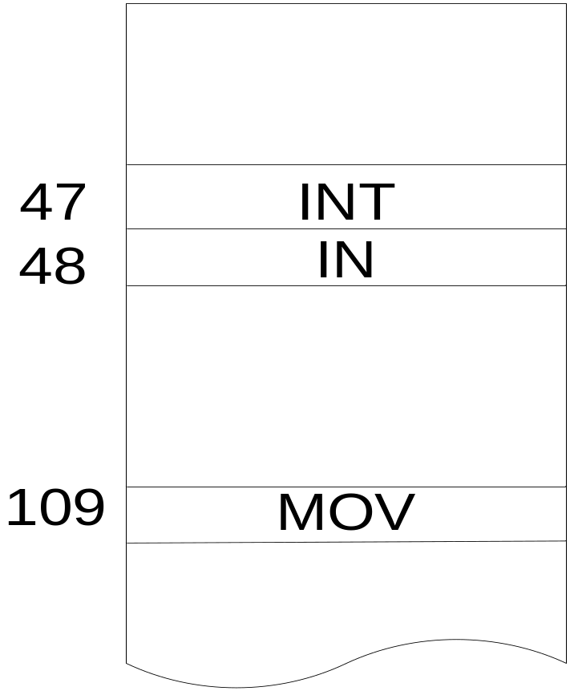
Instruction Table 1

Slide 30
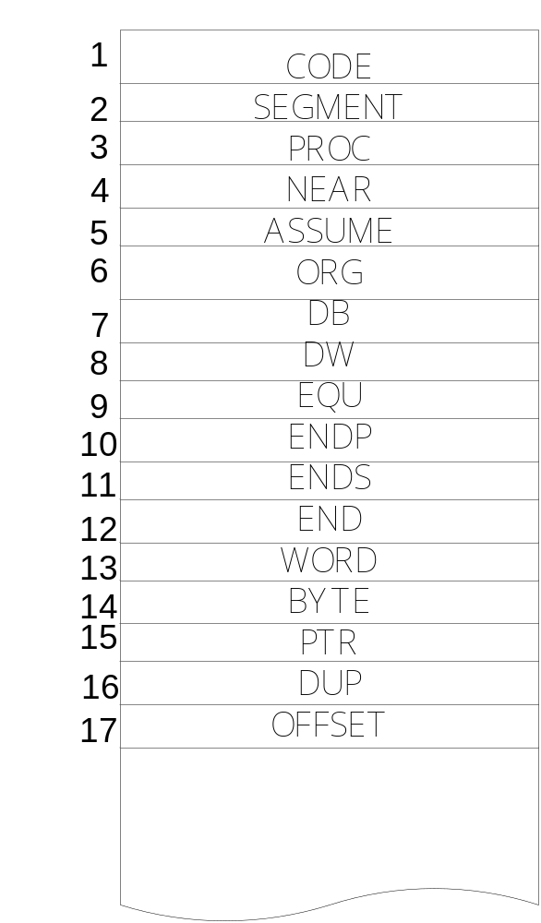
Pseudo and Extra Table 2

Slide 31
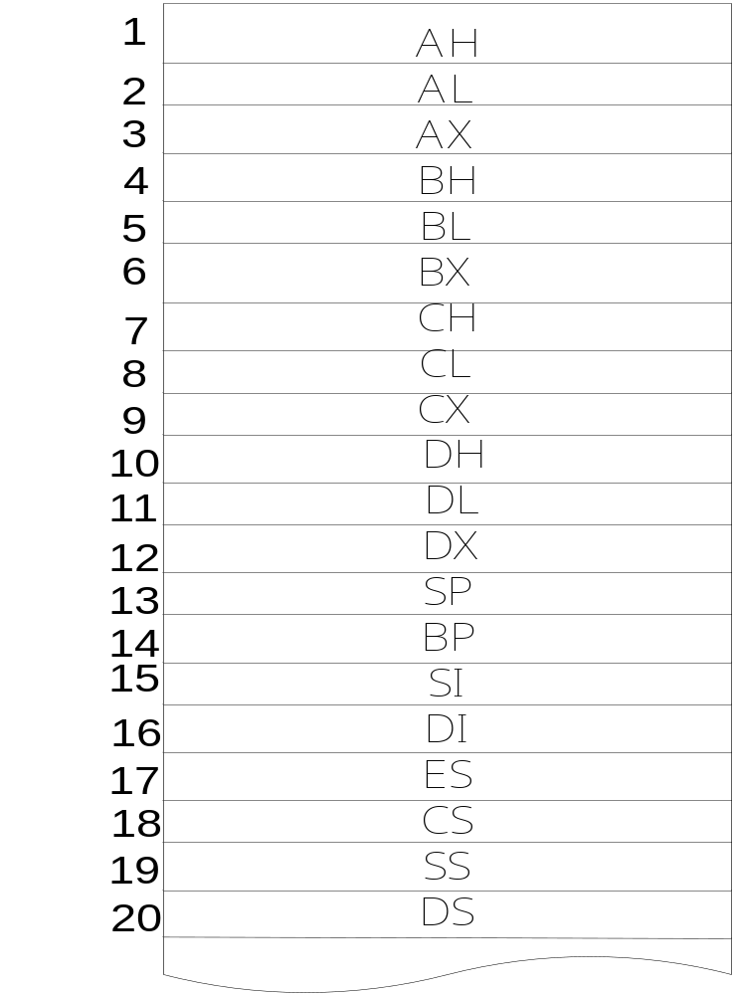
Register table 3

Slide 32
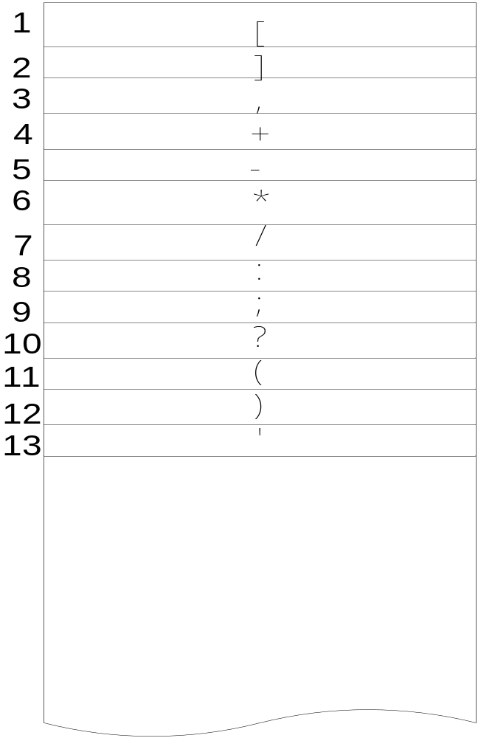
Delimiter Table 4

Slide 33
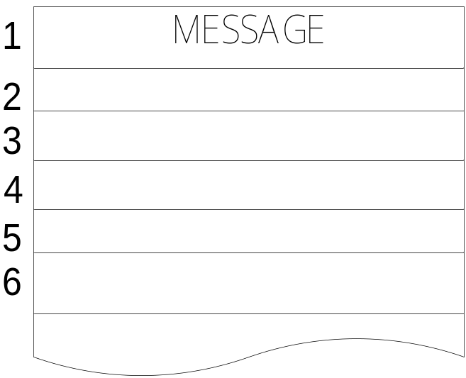
Symbol Table 5

Slide 34
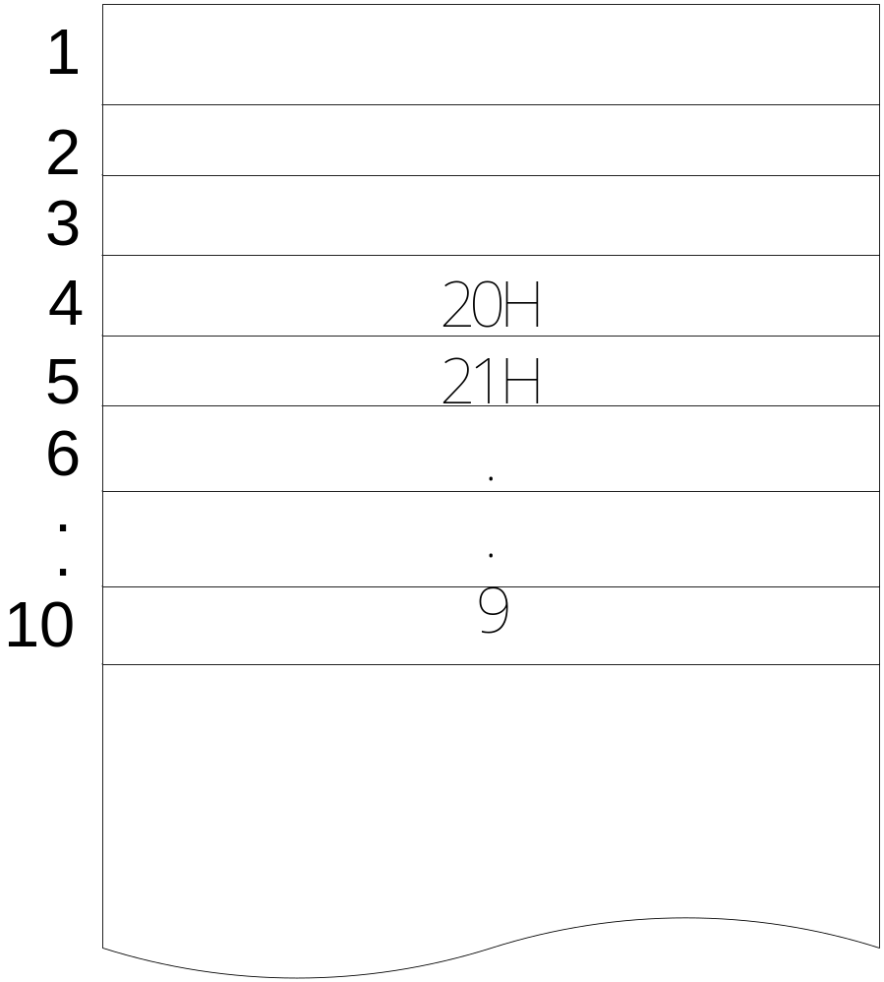
Integer/Real Table 6

Slide 35
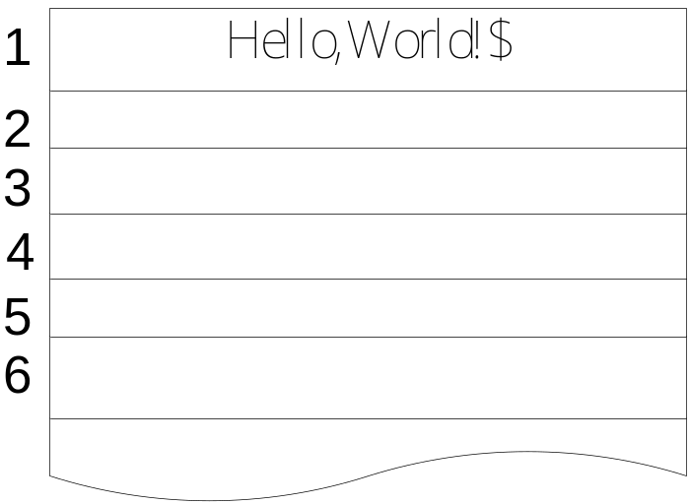
String Table 7

Slide 36
Useless information for assembler
Space/Tab
Enter
– only used for determining the end of line
Comment
– begin with semicolon (;)
Comma
– used for dividing operand/literal
Colon
– end of label (as language definition)

Slide 37
Example 1 - Hello World!;
; Program: Hello World !
MOV AH, 9
MOV DX, OFFSET(MESSAGE)
INT 21H ;call DOS
INT 20H ;return to DOS
MESSAGE DB 'Hello, World!$'

Slide 39
Lexical Analyzer
MOV AH , 9
(1,109) (3,1) (4,3) (6,10)
MOV DX , OFFSET ( MESSAGE )
(1,109) (3,12) (4,3) (2,17) (4,11) (5,1) (4,12)
INT 21H
(1,47) (6,5)
INT 20H
(1,47) (6,4)
MESSAGE DB ` Hello,World!$ `
(5,1) (2,7) (4,13) (7,1) (4,13)

Slide 40
如何切Token
Space/Tab/Enter (white space)
Delimiter
[，] ，, ，+，-，…
範例:
MOV WORD PTR [ BP ] [ DI ] + 1234H

Slide 41
Lexical Analysis 方法
找到white space 或 Delimiter
當遇到white space,到各table內查是否為預先設定之指令,符號,…等,如果是則建立token
當遇到Delimiter,則到各table內查並建立token(可能有一個或兩個token)
若查表沒有此token,表示它為symbol或integer/Real或String,以Hashing function將其放入table內

Slide 42
Hash function
將identifier 中的每個字元的ASCII 碼相加之後取 100 的餘數
有碰撞產生,就向後遞增至空的地方

Slide 43
作業繳交
Lexical Analysis (Token Report)
10月下旬

Slide 44
Syntax Analysis實作
分辨為token,並依文法需求保留下label,opcode,opeand資訊

Slide 45
Useful information for assembler
opcode
– MOV, ADD, JP, …
– can be stored in a table to access easily
operand
– “AX,09h” “AL, Label+2” “dx, offset(A)” …
– have to be divided into several parts
label
– “A DB ‘1234$’” “A: MOV AX, BX”… .
– recognize and store in a different table

Slide 46
Operand grammar
2-parameter operand
– REG, REG
– REG, address
– REG, number
– ...
1-parameter operand
– label
– offset(something)
– ...

Slide 47
Lexical Analysis及Syntax Analysis後之結果
Example 1
MOV AH , 9
(1,109) ( 3,1)(4,3) (6,10) ←token
←token Group
opcode
oprand1
oprand2
register
number

Slide 48
Lexical Analysis及Syntax Analysis後之結果
Example 2
MOV DX , OFFSET(MESSAGE)
(1,109) (3,12) (4,3) (2,17) (4,11) (5,1) (4,12)
opcode
oprand1
oprand2
register
offset

Slide 49
如何翻Machine code
指令分類
各指令與機器碼的對照表
Symbol Table之進一步考慮
其他必須之tables

Slide 50
ASMer Writing Techniques
指令行 OP Code 同類項
AAD D5 0001
AAM D4 0001
ADD 00 0020
AND 20 0020
CMP 38 0020
OR 08 0020
SBB 18 0020
SUB 28 0020
XOR 30 0020

Slide 51
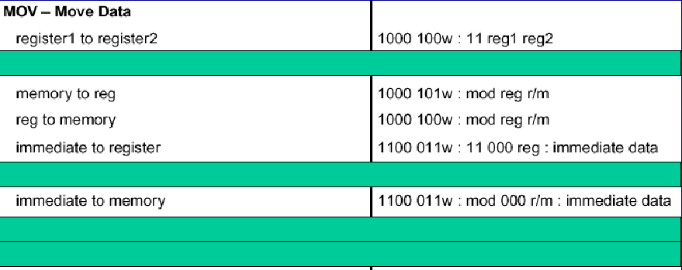
Encode MOV Instruction
MOV instruction format (Partial)

Slide 52
Encode Data
Op2 Op1 OPCode D W Mod
REG REG 100010 0 ? 11
MEM REG 100010 0 ? ??
IMM REG 110001 1 ? 11 no r/m
REG MEM 100010 1 ? ??
IMM MEM 110001 1 ? ?? no reg

Slide 53
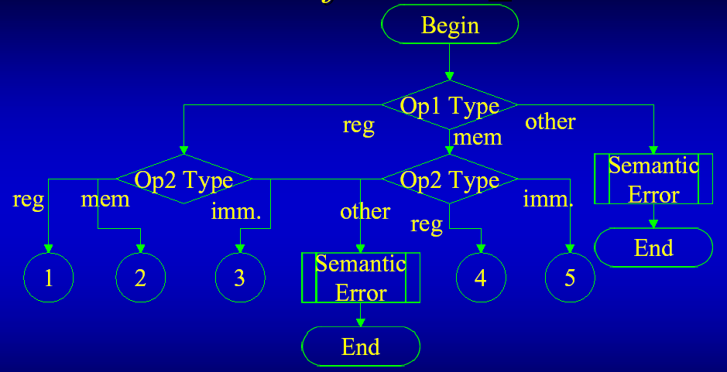
Flowchart of Handle_MOV

Slide 54
Kinds of Handle_MOV
OpCode D W MOD REG R/M
1. 100010 0 Test OP1 11 OP1 OP2
2. 100010 0 Test OP1 ?? OP1 OP2
3. 110001 1 Test OP1 11 000 OP1
4. 100010 1 Test OP1 ?? OP1 OP2
5. 110001 1 Test OP1 ?? 000 OP1

Slide 55
Something about MOV
• Check for Semantic Error
– Think about “data type” of operands.
– Check for type matching
• Byte
• Word
• DWord
– Check for Destination operand
• no literal

Slide 56
Instruction Table Lookup
Name Operand# Length# OpCode
Add 2 x ...
Mov 2 x ...
Jmp 1 x ...
Nop 0 1 ...
Start 0 0 ...
End 0 0 ...

Slide 57
Label/Symbol Table Lookup
Name Start End Type
Msg 0000 0010 string
Num1 0011 0012 word
Num2 0013 0013 byte
... ... ... ...

Slide 58
程式驗收
期中考後一周

Slide 59
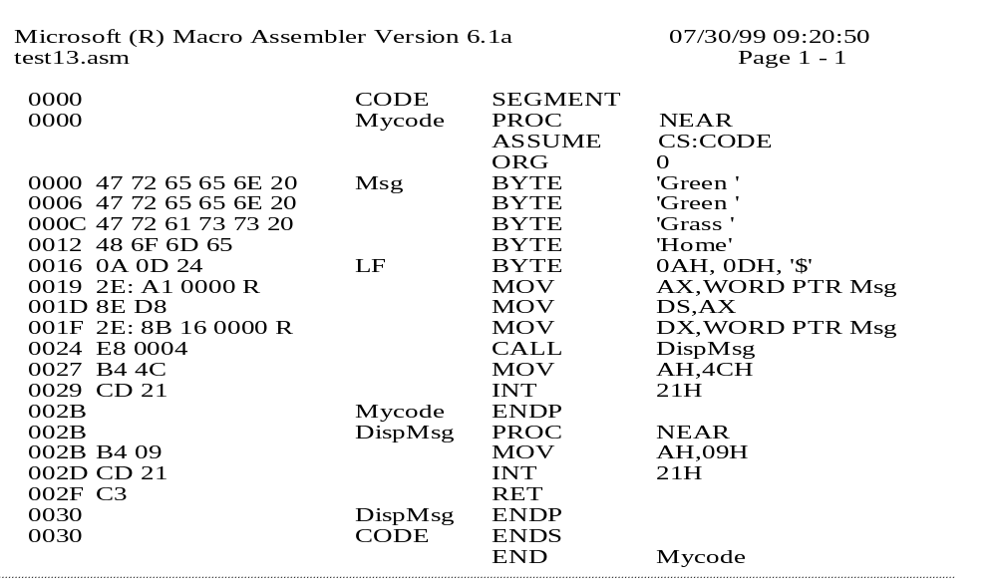
輸出格式

Slide 60
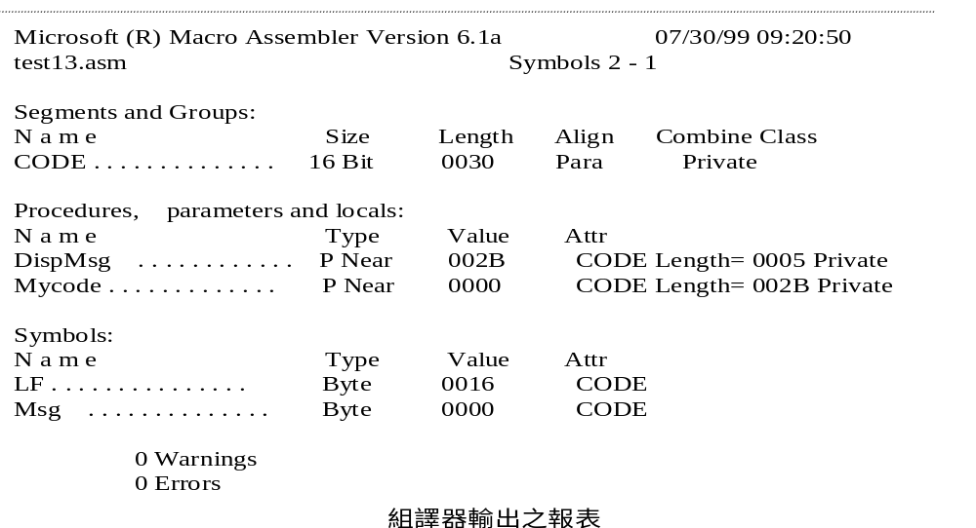
輸出格式

